Slide 1
Sugon Company Overview
Moscow, 12/2015

Slide 2
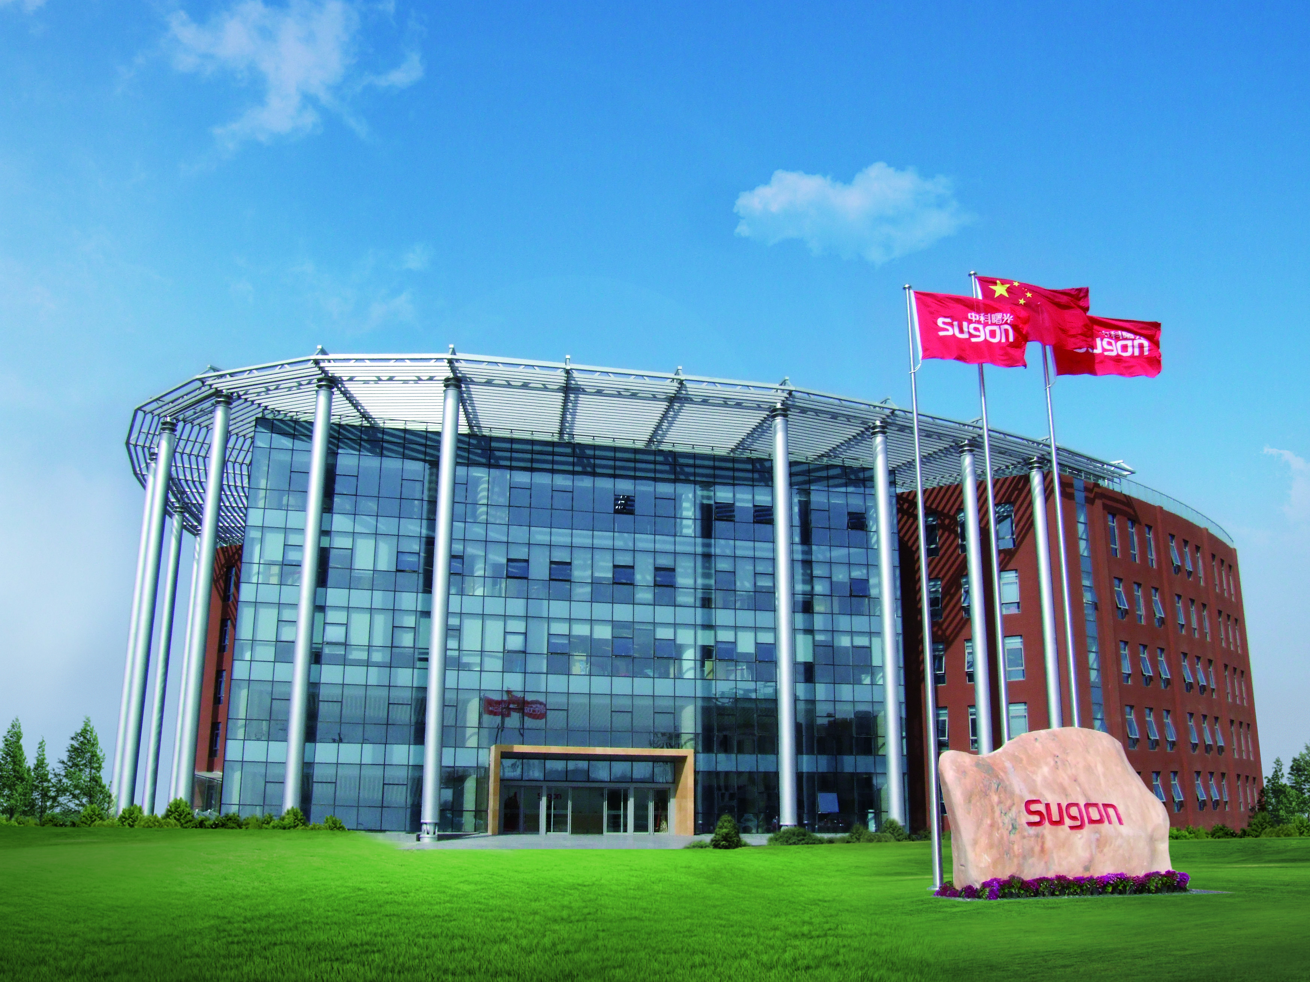
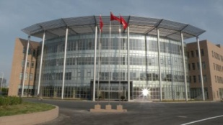


Sugon Overview
  High-Tech Company
  Founded in 1995, owned by Chinese Academy of Sciences (CAS)
  Supported by ICT, National research institute, our biggest share holders
  Over 2000 employees, 35% with M.S. Degree
Manufacture
  Tianjin factory, the biggest server factory in Asia
  Panjin factory, advanced SMT product lines
  Internationalization, ODM model, adopt Tier 1 venders(Foxconn, Supermicro)
Notes:
CAS is the national academy of china. It supervises and supports research activities in a wide variety of disciplines
The Institute of Computing Technology (hereafter ICT) is the first National research institute which specialize in computing science and technology in China.
The ICT is also the place where China’s first general-purpose CPU chip was born (Loongson).

Slide 3
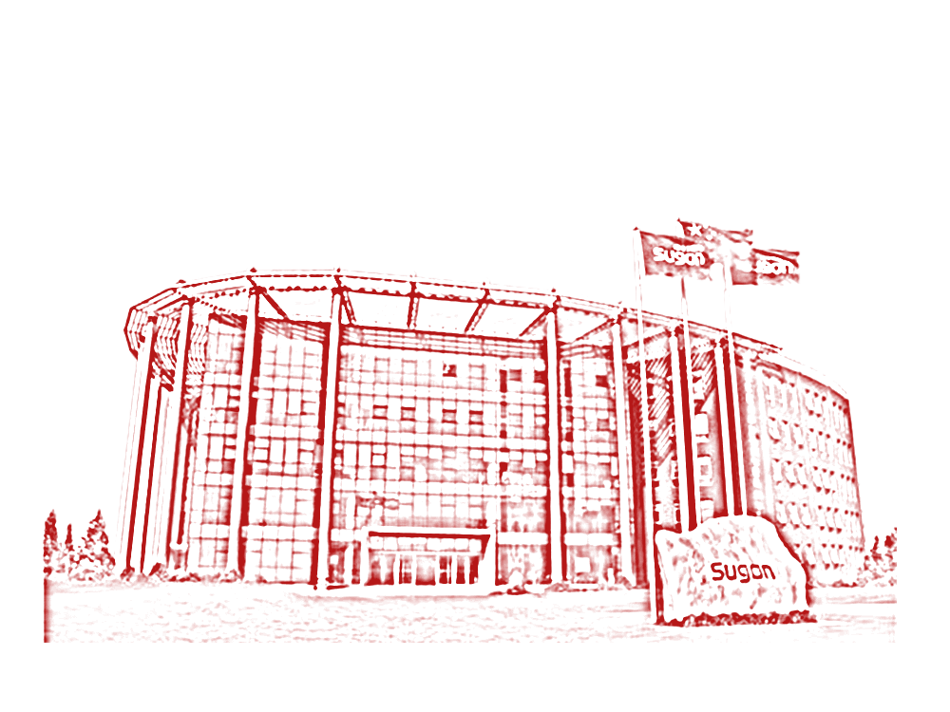

Strategic Position of Sugon
A Successful company in connecting Fundamental Research with Product Markets
Leading the Industrialization of National Innovations
In-depth cooperation with customers in cutting-edge technology

Slide 4
Progress with China
Design in China, Service for Global
First Developer of
8-way X86 Server
In China
First Developer of
Blade Server
In China
First Commerial
Public Cloud
In China
First Developer of
Storage Server
In China
First Developer of
Petaflops
Supercomputer

Slide 5
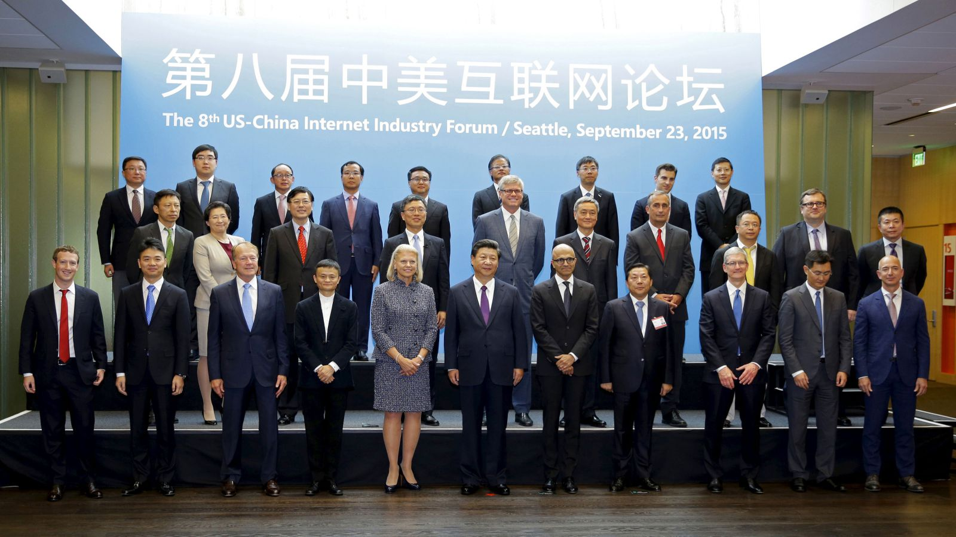
Sugon in Sino-America Internet Forum
"Digital economy is driving the reform in different fields, its development level represents the state’s competition capability. Plentiful successful cases from America are worthy of learning in China. IT enterprises have obtained plentiful experiences in continuous exploration in China. The market space is huge in China and America. As a leading enterprise in high-performance computing and cloud computing service in China, Sugon expects much to carry out the mutually-trusted cooperation in data computing fields and see the global win-win in digital economy. “
——Li Jun

Slide 6


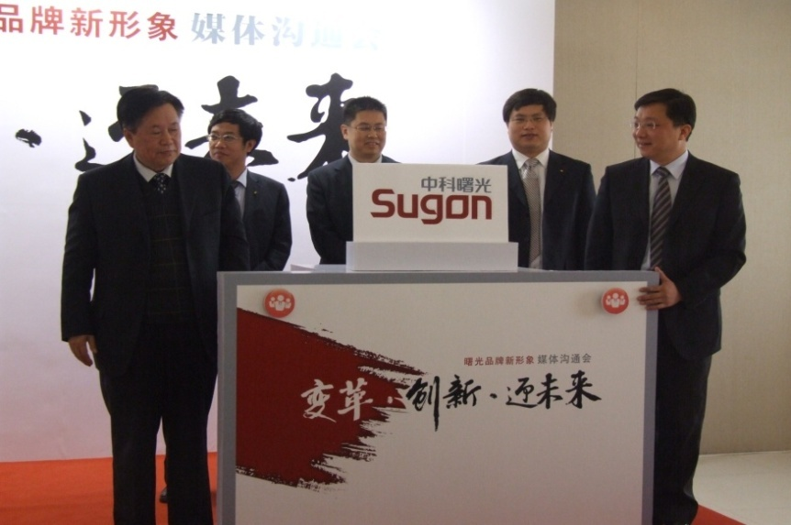
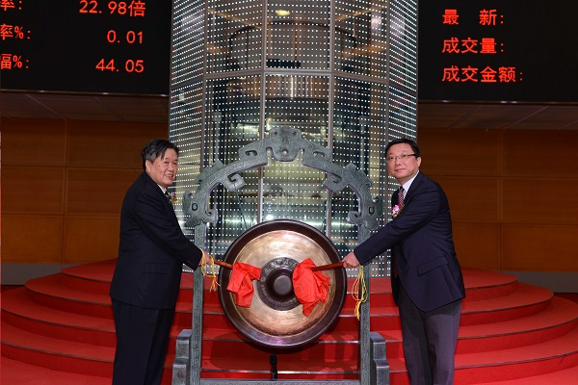
Match 30, 2011
Go to the Global Market
Division of Oversea
Oversea Distributers & Partners

Slide 7

Sugon in fast lane
Marketing share increases rapidly
Industry influnce enhances continously
No.1
No.1
No.1
50%+
40%+
2014
Break-through
in Finacial industry
2014
Rank No.1
in Telecom industry
HPCTOP100 five consecutive champions
a growth rate of over 50% for three years in Internet
2014
Rank No.1
in electric power industry

Slide 8
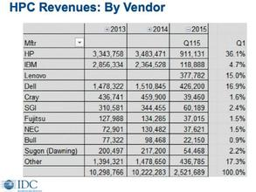
Top HPC vender in the world
IDC ranks first in Asia, sixth in the world.
Sugon(Dawning) 200,497 217,200 54,468 2.2%
The 3rd manufacturer of the Top500 Vendors

Slide 9
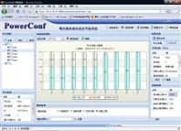
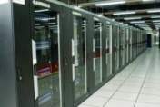

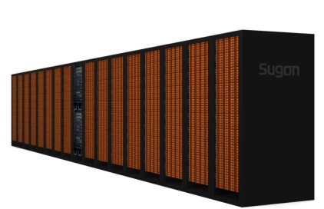
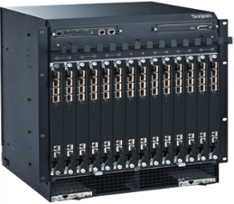
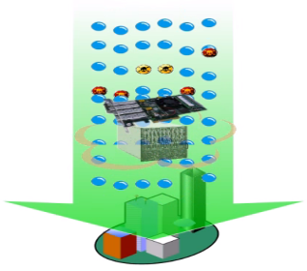

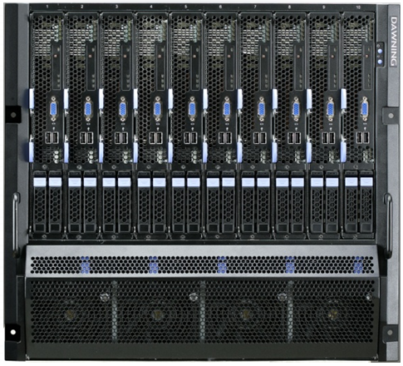
Sugon Product lines
  TC6000
  TC4600
  GridView
HPC
CloudView
CloudDesktop
AppFoundry
Blade Server、AMD Serials
Intel Serials、High Density
Cloud
Storage
Data Center
  ParaStor
  Xdata
  FC SAN
Special Security
Independent Server
FlowFirm
Infrastru-cture
Security
Normal Cabinet
Immersion Server
Micro Module
Consultant Service
Notes:
资源池化、应用分布化、服务自动化

Slide 10






Total Solutions
City Cloud
Smart City
High Performance
Computing
Private Cloud
Big Data
Disaster
Recovery
Data Center
Security
PAAS
U2L/U2VL

Slide 11
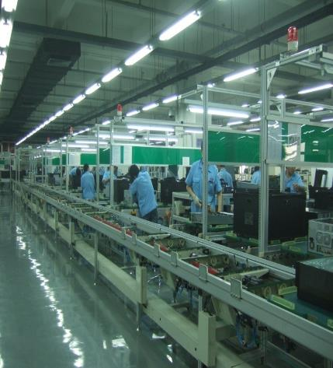
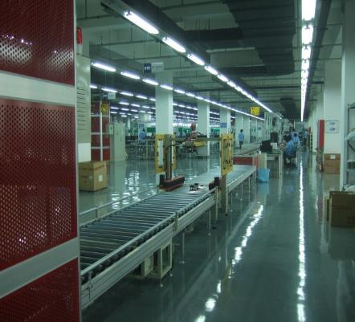
Quality Assurance
High-level standard production line, Automatic packing line
Production capacity 200K servers/yr., expandible to 500K servers/yr..
22 steps in Design procedures,
5,000 aspects in Testing procedures
ISO 9001, ISO 14001 Certificated

Slide 12
Open & Invest
Survive
Flexible
Collaboration
Communication

Slide 13
Contact Information
Ms. Maggie Han 韩美筠
Business
+86 186-0124-8985
hanmj@sugon.com
Mr. Chongshan Zhao 赵崇山
Technical
+86 186-1173-4965
zhaocs@sugon.com

